Slide 1
Geologic Time scale and Fossils

Slide 2
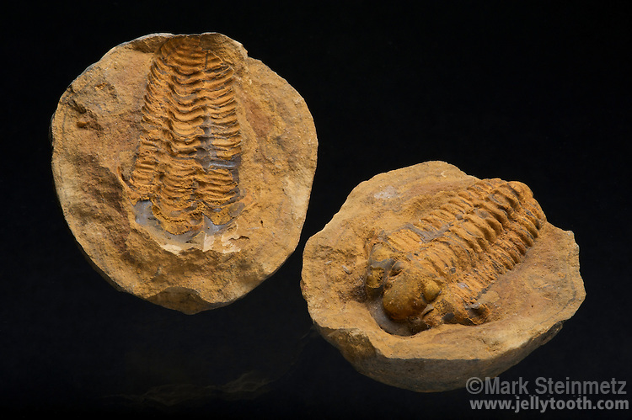
Which is a mold and which is a cast?

Slide 3
Mold versus a cast
Mold- is hollowed out part of rock, leftover from after an organism has decayed
Cast – when a mold fills with minerals and hardens into rock

Slide 4
Which is a mold and which is a cast?

Slide 6
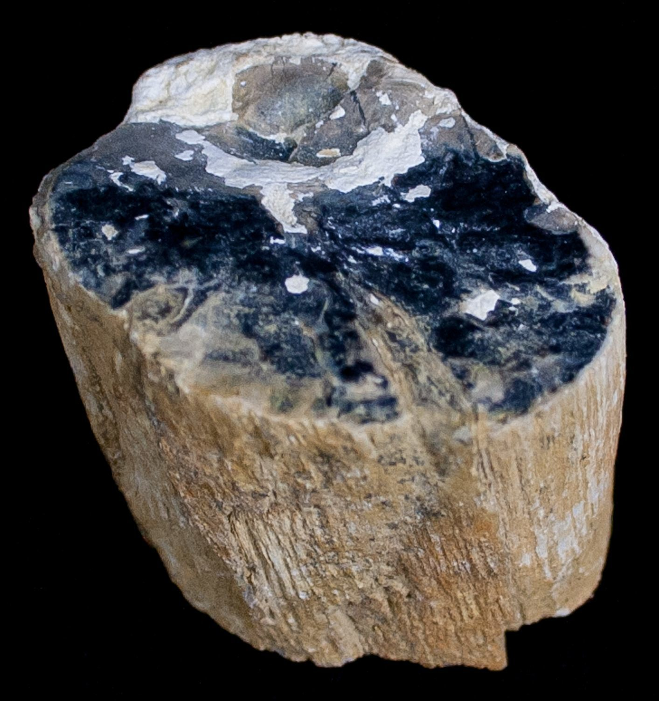
Petrification
The dead organism dissolves in water and is replaced by minerals and turns to stone

Slide 7
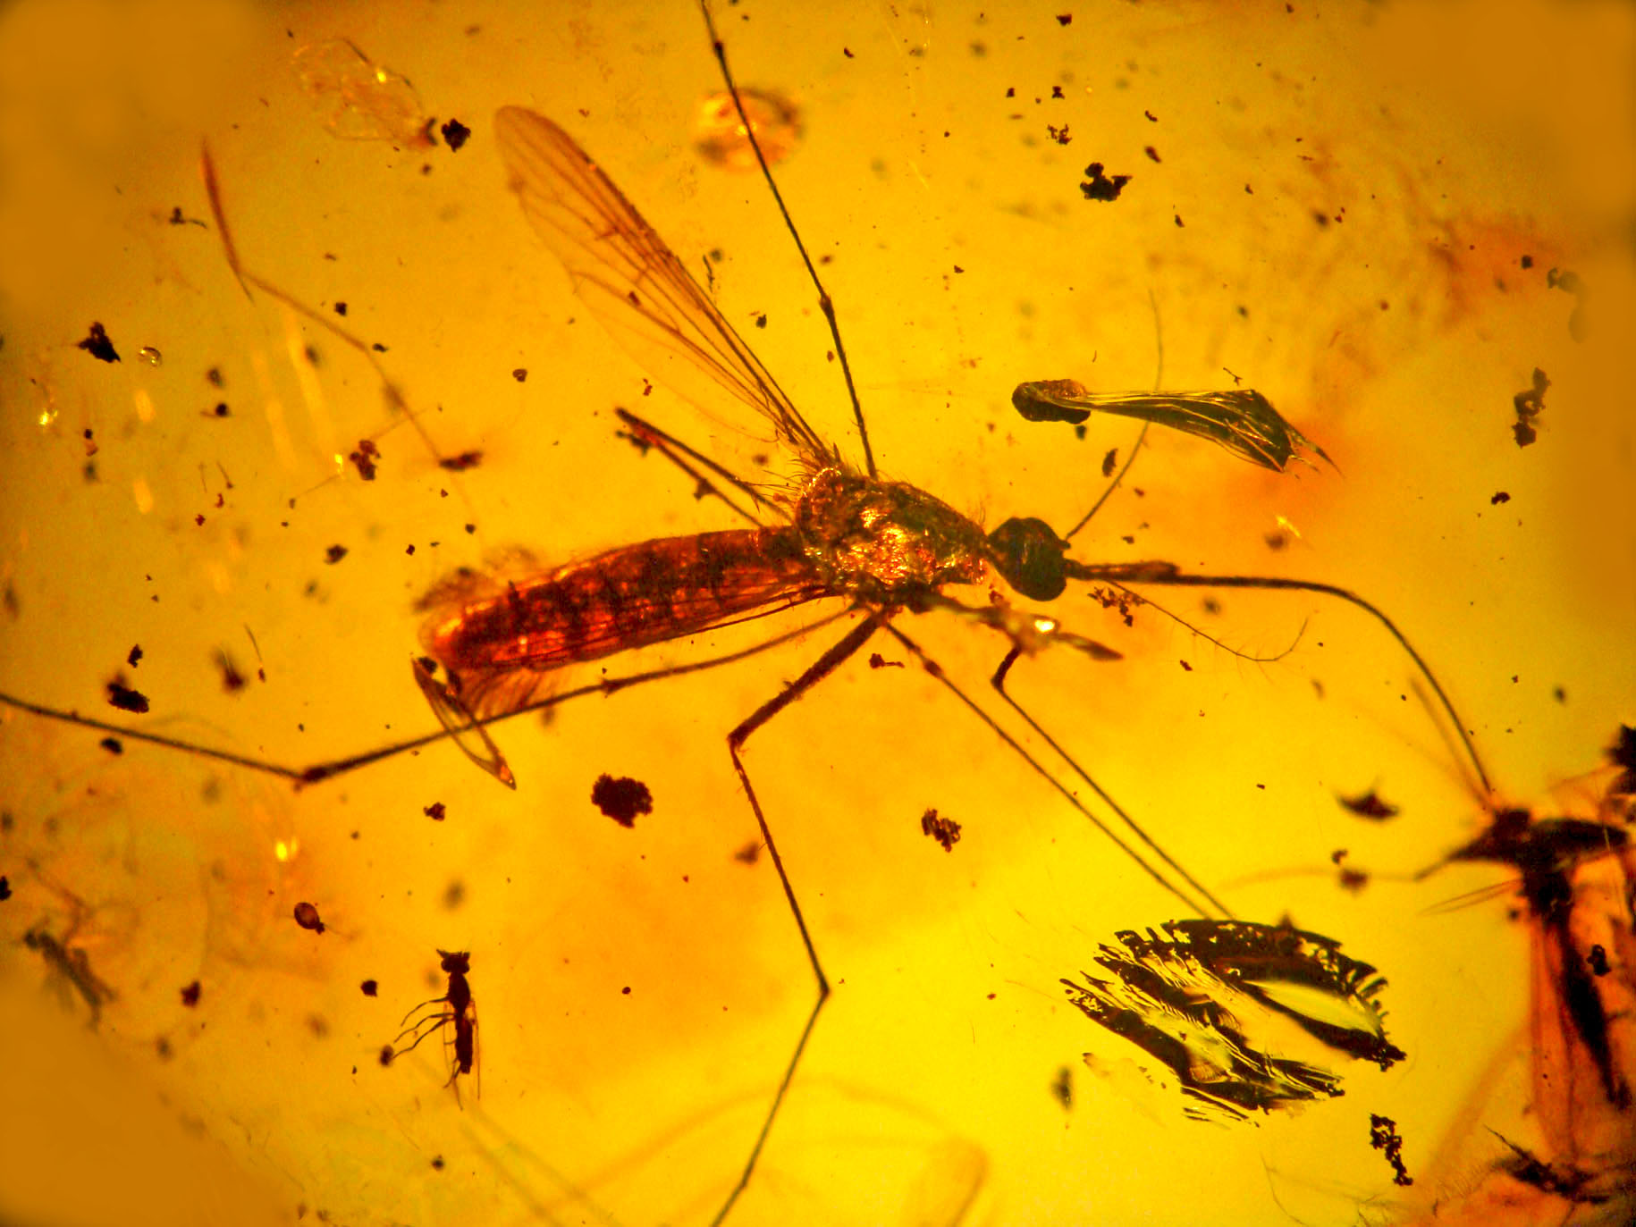
Amber- hardened tree sap that can trap insects or other small organisms within it. Ice and peat bogs can “trap” and cover organisms as well.

